Slide 1


F.P.S
Free Parking Spot

Slide 2

Why do we need F.P.S

Slide 3

Prototype Diagram

Slide 4
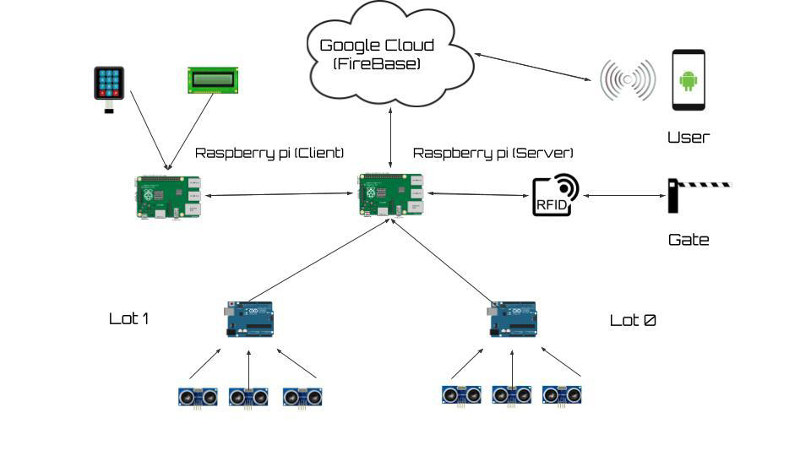
Problem

Slide 5

(Server)

Slide 6
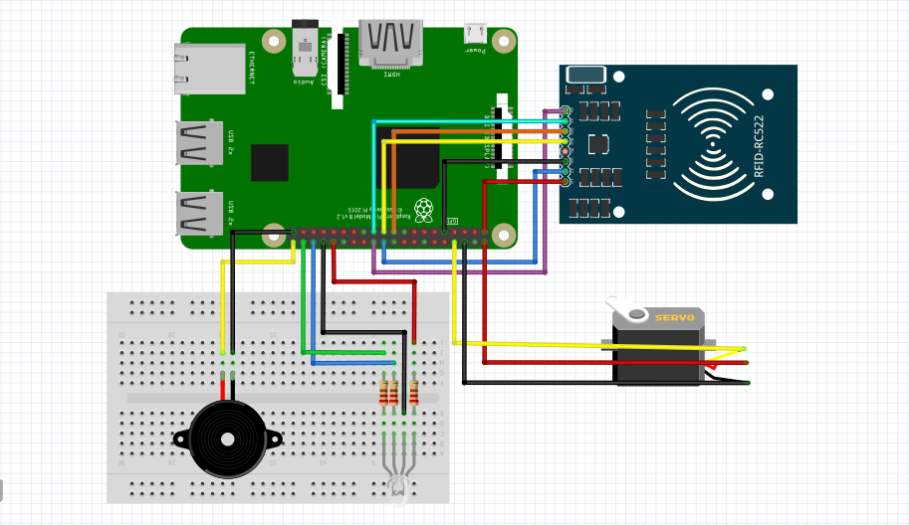
Proposal

Slide 7
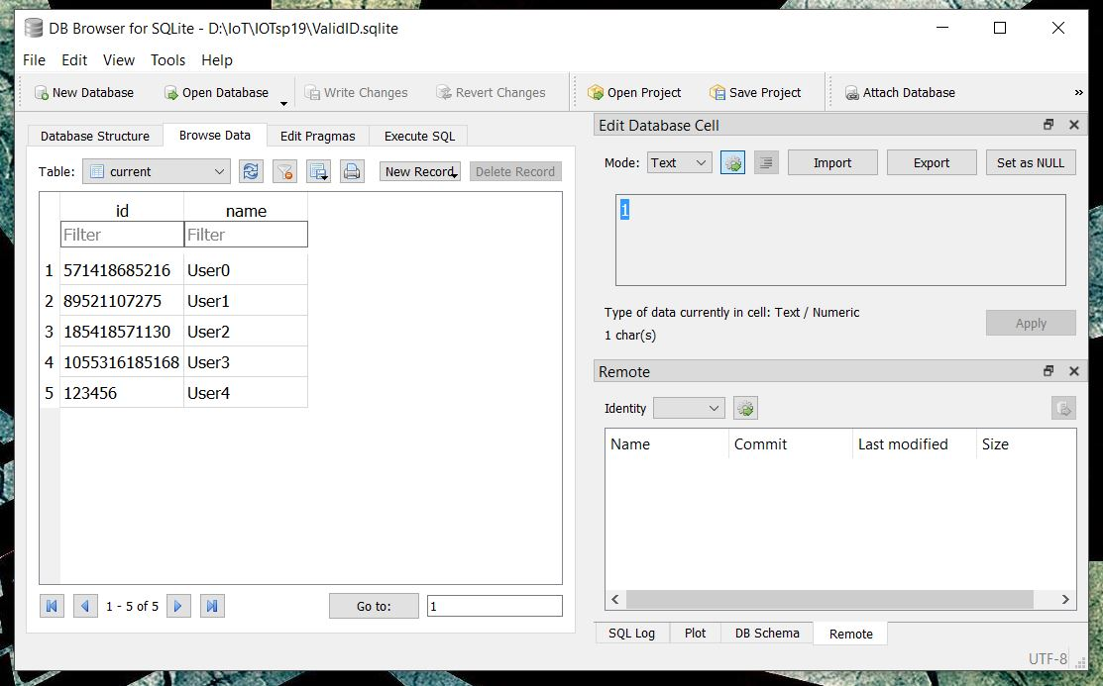

Slide 8

Setup

Slide 9
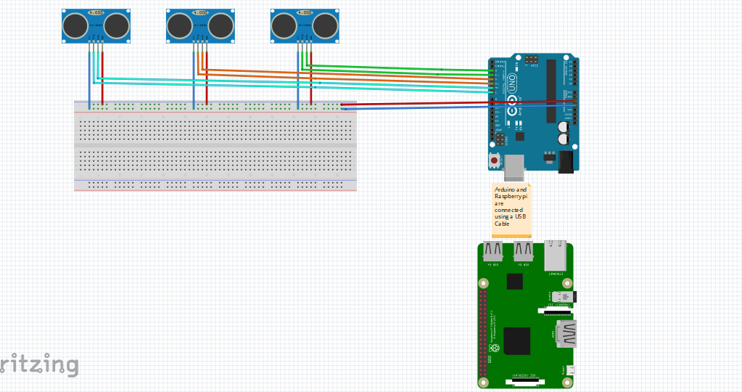

Slide 10
(Client)

Slide 11
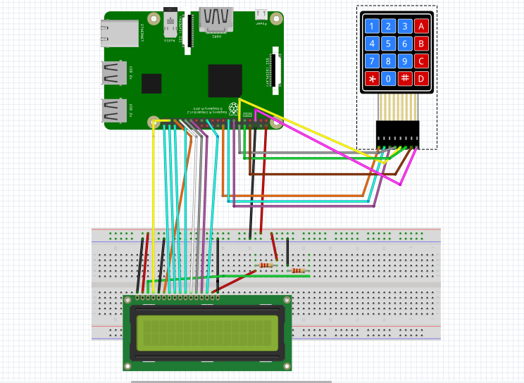
Business Model

Slide 12

App Design

Slide 13

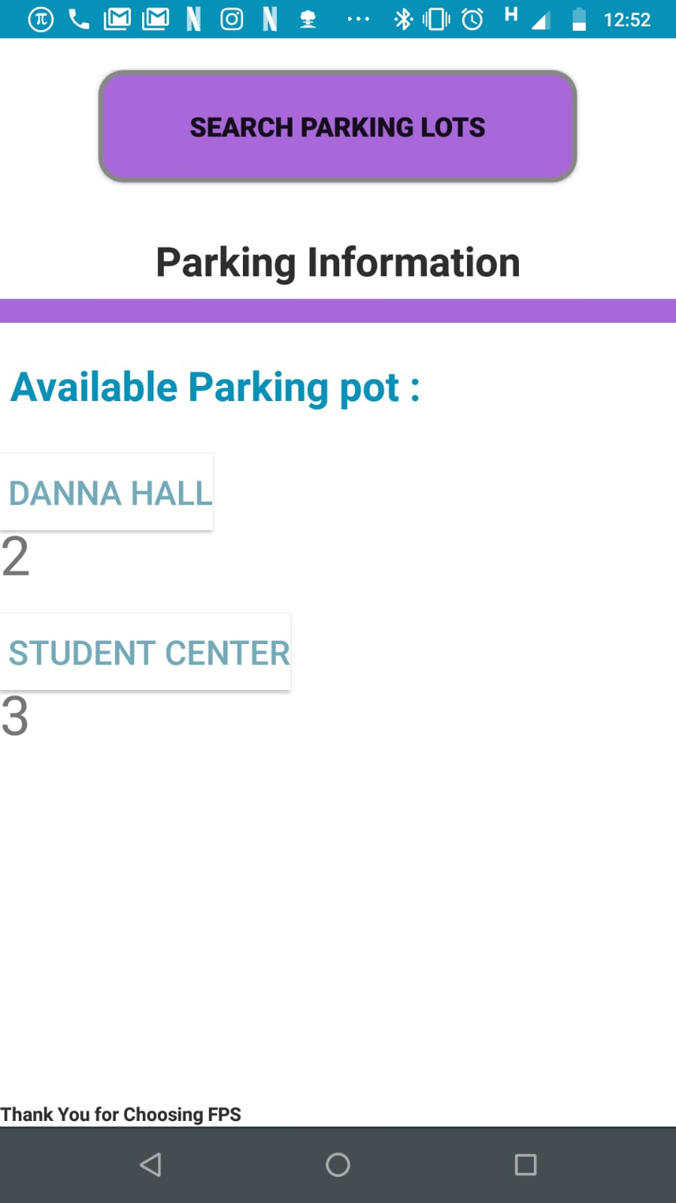
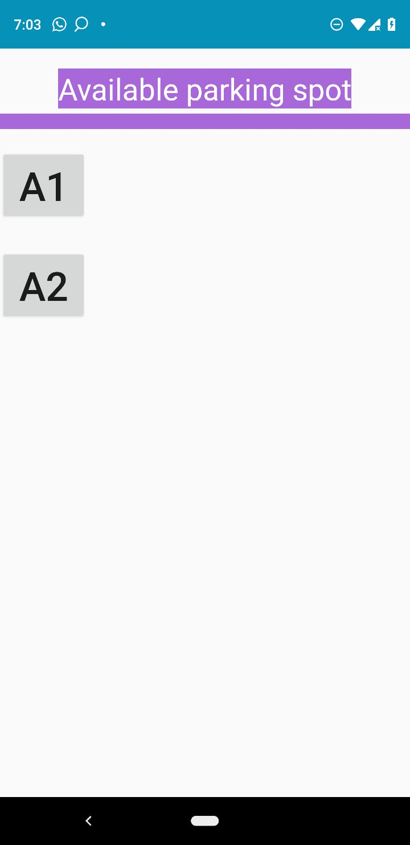
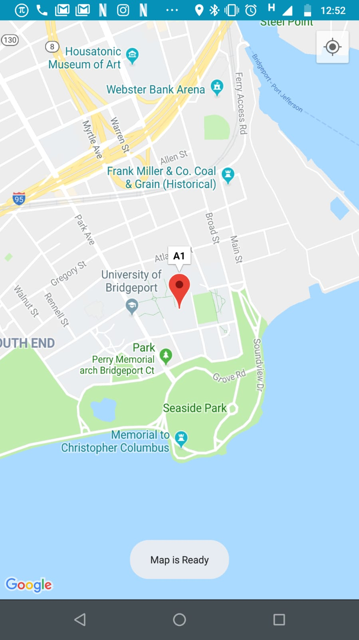

Slide 14
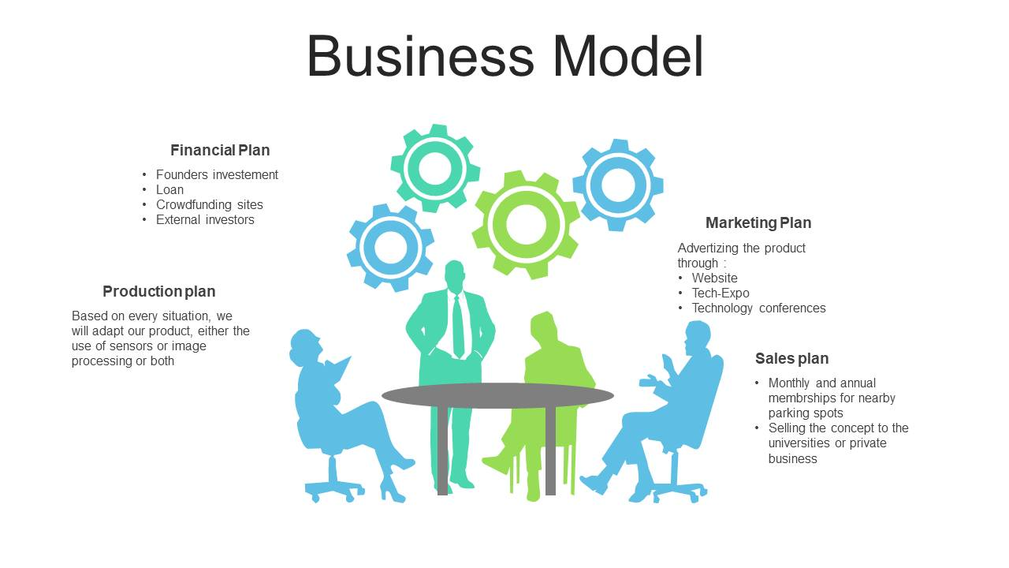

Slide 15
CONCLUSION

Slide 16


